Slide 1
Review Session 2
API-201, 9.17.21
Sophie Hill

Slide 2
Logistics
PSet 2 is out, due Tuesday am
PSet 1 solutions are posted on Canvas, and grades will be released by next week
Remember to come to Office Hours or use Slack to #askforhelp!
Video, slides, and worksheets from the Excel training sessions are also available now

Slide 3
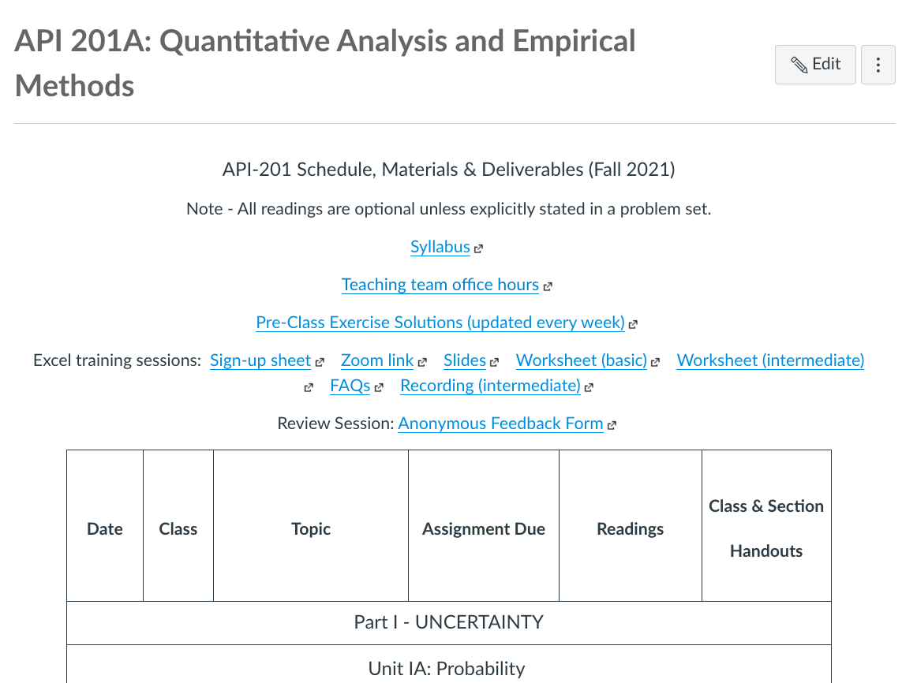
Logistics
Office hours schedule

Slide 4
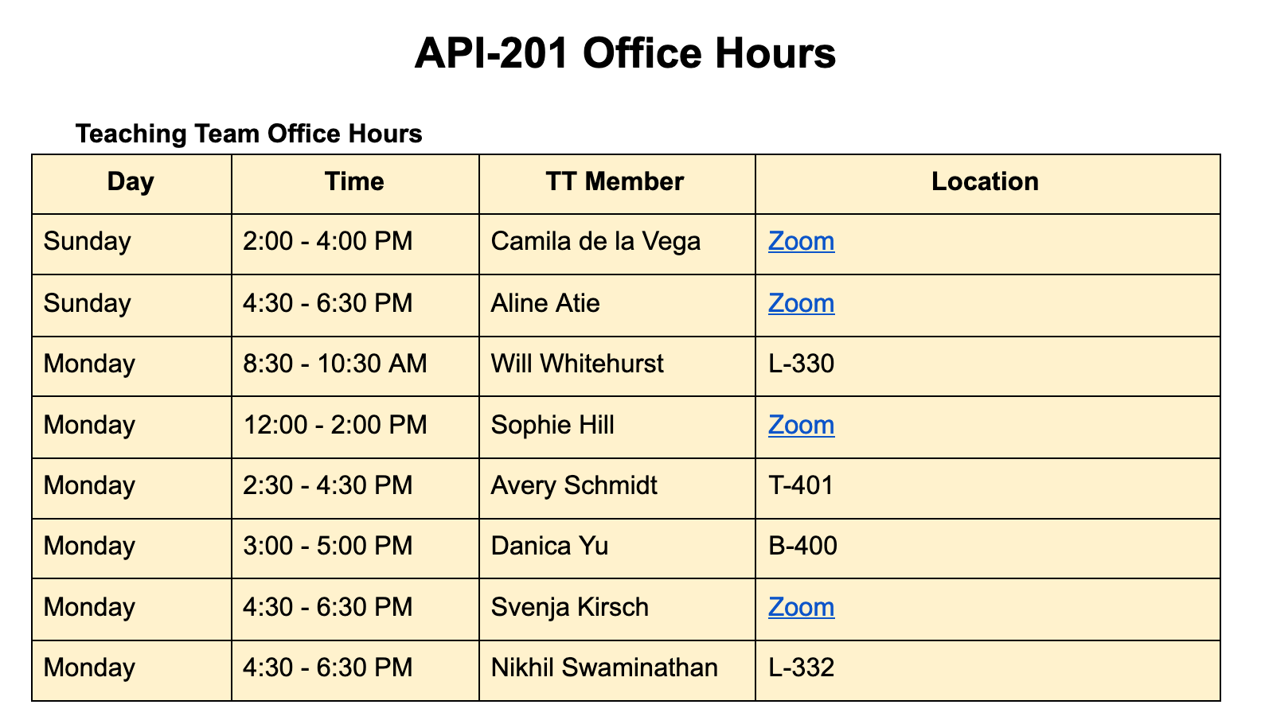
Logistics

Slide 5
Logistics
Excel training session materials

Slide 6
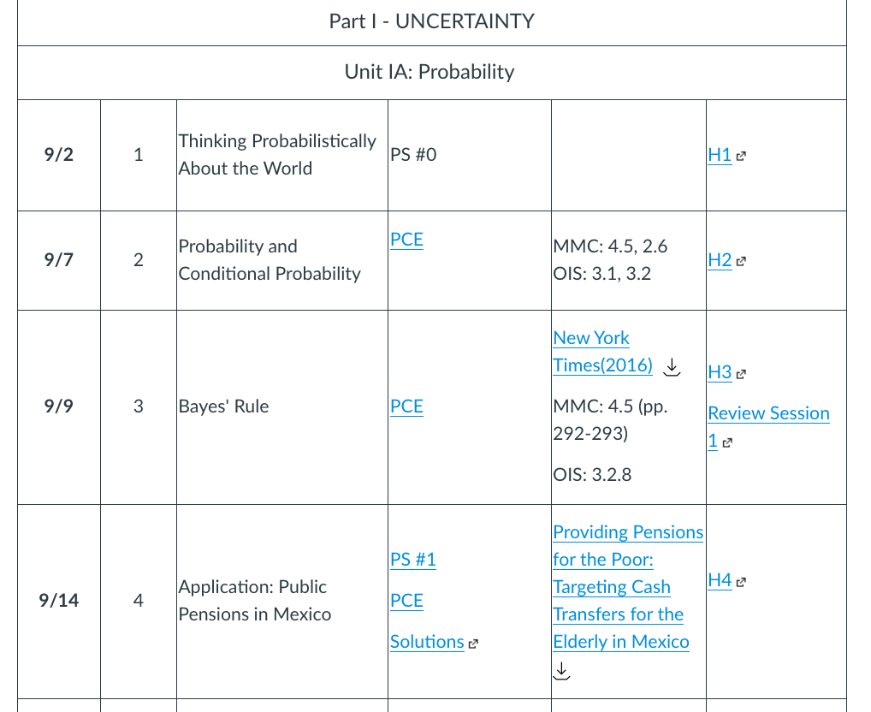
Logistics
Review Session slides

Slide 7
Logistics
PSet 1 solutions

Slide 8
Common confusions

Slide 9
Common confusions
Independent vs. mutually exclusive
Probabilities vs. counts
Complement of a conditional probability
Sensitivity vs specificity

Slide 10
Independent vs. mutually exclusive
From Handout 2:
Events A and B are independent if knowing that one event occurs does not change the probability we would assign to the other event.
Two events are disjoint (or mutually exclusive) if they cannot occur together.

Slide 11
Independent vs. mutually exclusive
Can we “translate” these definitions into formal probability notation?
From Handout 2:
Events A and B are independent if knowing that one event occurs does not change the probability we would assign to the other event.
Two events are disjoint (or mutually exclusive) if they cannot occur together.

Slide 12
Independent vs. mutually exclusive
Can we “translate” these definitions into formal probability notation?
From Handout 2:
Events A and B are independent if knowing that one event occurs does not change the probability we would assign to the other event.
P(A | B) = P(A)
Two events are disjoint (or mutually exclusive) if they cannot occur together.
P(A & B) = 0

Slide 13
Independent vs. mutually exclusive
From Handout 2:
Events A and B are independent if knowing that one event occurs does not change the probability we would assign to the other event.
P(being in section A | tall) = P(being in section A)
Two events are disjoint (or mutually exclusive) if they cannot occur together.
P(being in section A & being in section B) = 0

Slide 14

2. Probabilities vs counts
Sophie, I did Q2 using counts but my PSet group did it using probabilities…
which method is right?

Slide 15
2. Probabilities vs counts
Here’s the probability table from the mammograms example (Handout 3)
 |  | Cancer?
 |  | Yes | No
Test result | Positive | 0.00675 | 0.099 | 0.10575
 | Negative | 0.00225 | 0.8919 | 0.89415
 |  | 0.009 | 0.9909 | 1

Slide 16
2. Probabilities vs counts
To convert to counts, we multiply each cell by our population size (e.g. 1,000)
 |  | Cancer?
 |  | Yes | No
Test result | Positive | 0.00675 *1000 | 0.099 *1000 | 0.10575 *1000
 | Negative | 0.00225 *1000 | 0.8919 *1000 | 0.89415 *1000
 |  | 0.009 *1000 | 0.9909 *1000 | 1 *1000

Slide 17
2. Probabilities vs counts
To convert to counts, we multiply each cell by our population size (e.g. 1,000)
 |  | Cancer?
 |  | Yes | No
Test result | Positive | 6.75 | 99 | 105.75
 | Negative | 2.25 | 891.9 | 894.15
 |  | 9 | 990.9 | 1,000

Slide 18
2. Probabilities vs counts
What is P(Cancer | +) ?
 |  | Cancer?
 |  | Yes | No
Test result | Positive | 6.75 | 99 | 105.75
 | Negative | 2.25 | 891.9 | 894.15
 |  | 9 | 990.9 | 1,000

Slide 19
2. Probabilities vs counts
What is P(Cancer | +) ?
6.75 / 105.75 = 0.064
 |  | Cancer?
 |  | Yes | No
Test result | Positive | 6.75 | 99 | 105.75
 | Negative | 2.25 | 891.9 | 894.15
 |  | 9 | 990.9 | 10,000

Slide 20
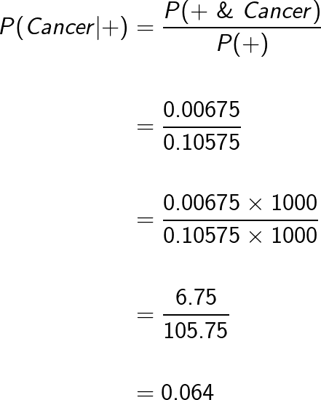
2. Probabilities vs counts
probabilities
multiply top and bottom by 1,000
counts
same answer!

Slide 21
2. Probabilities vs counts
Using probabilities is fine
Using counts is fine (perhaps easier?)
The only thing you need to remember is that you must be CONSISTENT!!
Always sense-check your answer:
Probabilities must be between 0 and 1
Counts must be between 0 and your total population size

Slide 22
3. Complement of a conditional probability
1 - P(A|B) = ???

Slide 23
3. Complement of a conditional probability
1 - P(A|B) = P(not A | B)

Slide 24
3. Complements of conditional probability
1 - P(A|B) = P(not A | B)
Why?
Let’s prove it...

Slide 25
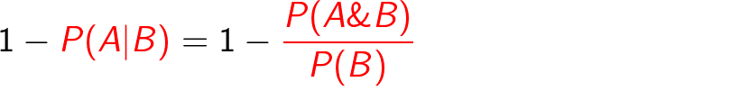
Multiplication rule

Slide 26
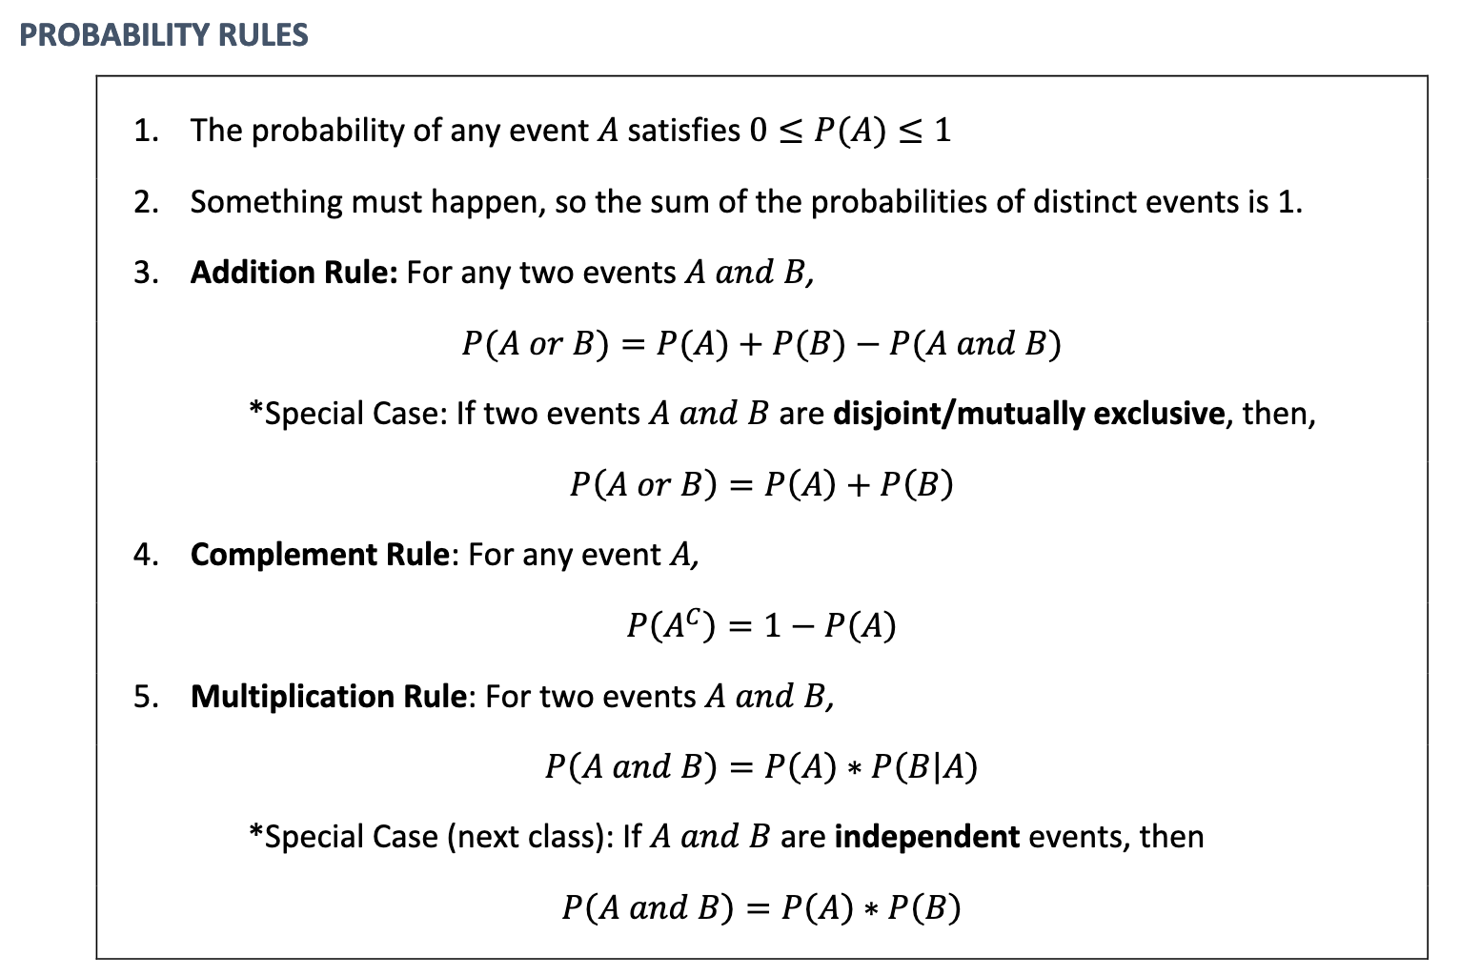
If you’re having trouble remembering the probability rules, print out this box from Handout 2 and have it in front of you when working on a PSet!

Slide 27
Multiplication rule

Slide 28
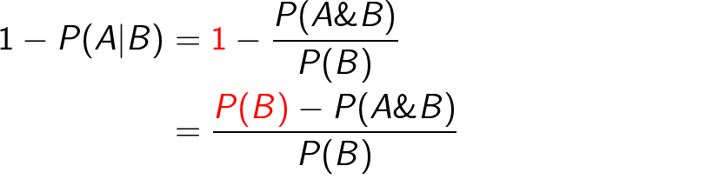
Rearranging

Slide 29
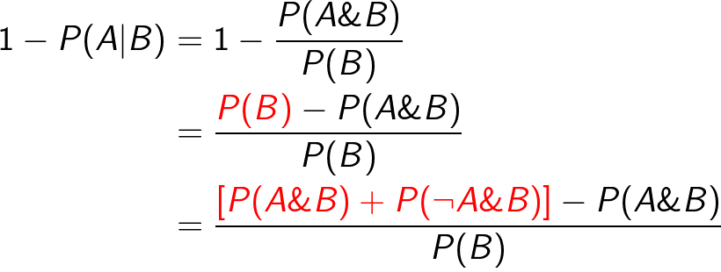
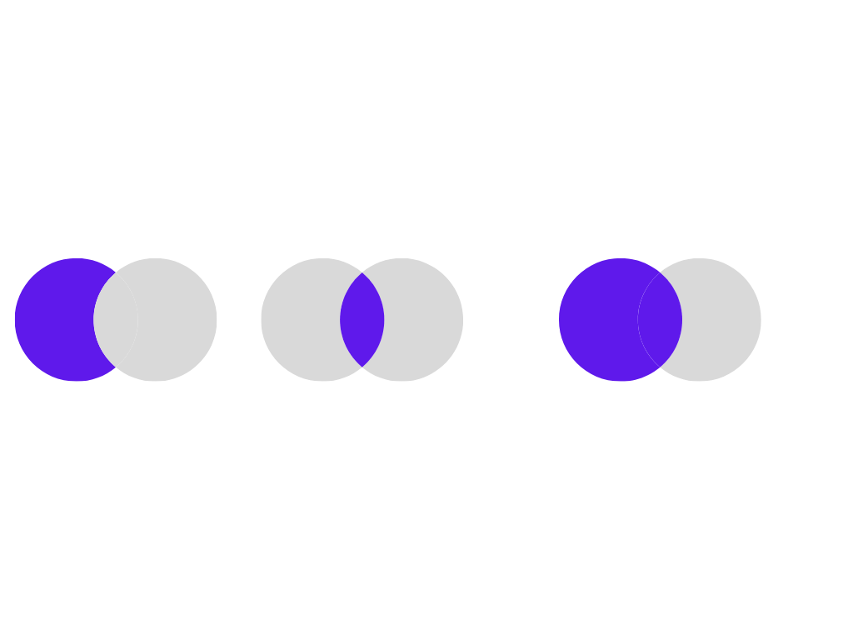
=
+

Slide 30
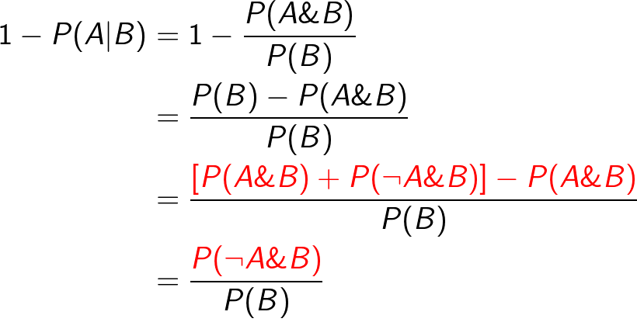

Slide 31
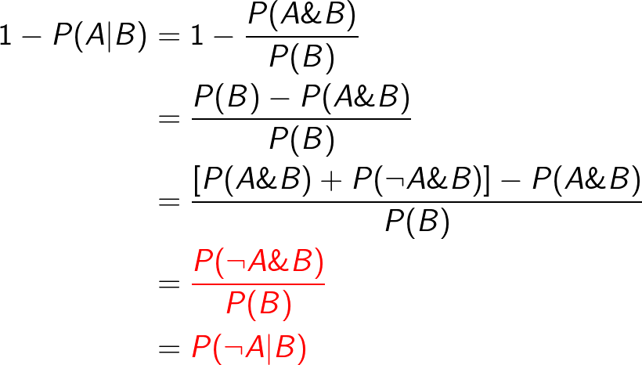
Multiplication rule
(again!)

Slide 32
Wow, that multiplication rule sure seems useful!!

Slide 33
Wow, that multiplication rule sure seems useful!!
“Conditional = Joint / 2nd Marginal”

Slide 34
Wow, that multiplication rule sure seems useful!!
“Conditional = Joint / 2nd Marginal”
P(A|B) = P(A&B) / P(B)
P(B|A) = P(A&B) / P(A)

Slide 35
4. Sensitivity vs Specificity
Sensitivity | P(+ | Disease) | Probability of correctly classifying those with the disease
1 - Sensitivity | P(– | Disease) | Probability of incorrectly classifying those with the disease
Specificity | P(– | No disease) | Probability of correctly classifying those without the disease
1 - Specificity | P(+ | No disease) | Probability of incorrectly classifying those without the disease

Slide 36
4. Sensitivity vs Specificity
Sensitivity | P(+ | Disease) | Probability of correctly classifying those with the disease
1 - Sensitivity | P(– | Disease) | Probability of incorrectly classifying those with the disease
Specificity | P(– | No disease) | Probability of correctly classifying those without the disease
1 - Specificity | P(+ | No disease) | Probability of incorrectly classifying those without the disease

Slide 37
4. PPV vs NPV
Positive predictive value | P(Disease | +) | Probability that a positive test result is a true positive
1 - PPV | P(No disease | +) | Probability that a positive test result is a false positive
Negative predictive value | P(No disease | –) | Probability that a negative test result is a true negative
1 - NPV | P(Disease | –) | Probability that a negative test result is a false negative

Slide 38
4. PPV vs NPV
Positive predictive value | P(Disease | +) | Probability that a positive test result is a true positive
1 - PPV | P(No disease | +) | Probability that a positive test result is a false positive
Negative predictive value | P(No disease | –) | Probability that a negative test result is a true negative
1 - NPV | P(Disease | –) | Probability that a negative test result is a false negative

Slide 39

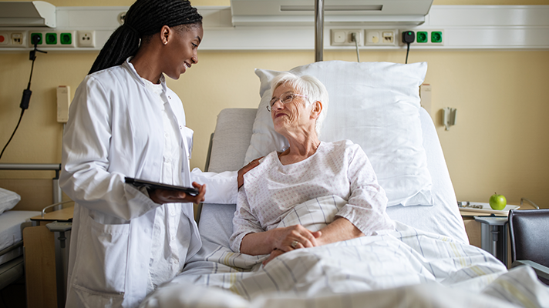
4. Sensitivity and Specificity vs PPV and NPV
Sensitivity and specificity are what matters to the medical testing company - they want to make the test as accurate as possible.
PPV and NPV are what matters to the patient - they want to know what the test results means in terms of their own health!

Slide 40
4. Sensitivity and Specificity vs PPV and NPV
P(test result | condition)
P(condition | test result)
Sensitivity and specificity are what matters to the medical testing company - they want to make the test as accurate as possible.
PPV and NPV are what matters to the patient - they want to know what the test results means in terms of their own health!

Slide 41
Problem Set 1,
Question 2 😱

Slide 42
PS1, Q2: Validation
The most important thing to say about this question is:
well done everyone!
It’s a hard question, especially this early in the semester.
If you found it tricky, don’t panic. It is tricky!
Bayes rule is a core concept in this class. It is 100% worth your time to review this question until you are comfortable with it.

Slide 43
PS1, Q2: Strategy
Abbott reports that this test has a specificity (P(Negative Test | No COVID)) of 98.5% and a sensitivity (P(Positive Test | COVID)) of 84.6%. Assume that the prevalence of COVID-19 (i.e., the proportion of people who are currently infected) is 1% in your population of interest.
What is the first thing we do with a question like this?
Guess the answer
Panic
Write out all the information in formal probability notation

Slide 44
PS1, Q2: Strategy
Abbott reports that this test has a specificity (P(Negative Test | No COVID)) of 98.5% and a sensitivity (P(Positive Test | COVID)) of 84.6%. Assume that the prevalence of COVID-19 (i.e., the proportion of people who are currently infected) is 1% in your population of interest.
What is the first thing we do with a question like this?
Guess the answer
Panic
Write out all the information in formal probability notation

Slide 45
PS1, Q2
Abbott reports that this test has a specificity (P(Negative Test | No COVID)) of 98.5% and a sensitivity (P(Positive Test | COVID)) of 84.6%. Assume that the prevalence of COVID-19 (i.e., the proportion of people who are currently infected) is 1% in your population of interest.
P(– | No COVID) = 0.985

Slide 46
PS1, Q2
Abbott reports that this test has a specificity (P(Negative Test | No COVID)) of 98.5% and a sensitivity (P(Positive Test | COVID)) of 84.6%. Assume that the prevalence of COVID-19 (i.e., the proportion of people who are currently infected) is 1% in your population of interest.
P(– | No COVID) = 0.985
P(+ | COVID) = 0.846

Slide 47
PS1, Q2
Abbott reports that this test has a specificity (P(Negative Test | No COVID)) of 98.5% and a sensitivity (P(Positive Test | COVID)) of 84.6%. Assume that the prevalence of COVID-19 (i.e., the proportion of people who are currently infected) is 1% in your population of interest.
P(– | No COVID) = 0.985
P(+ | COVID) = 0.846
P(COVID) = 0.01

Slide 48
PS1, Q2
Abbott reports that this test has a specificity (P(Negative Test | No COVID)) of 98.5% and a sensitivity (P(Positive Test | COVID)) of 84.6%. Assume that the prevalence of COVID-19 (i.e., the proportion of people who are currently infected) is 1% in your population of interest.
P(– | No COVID) = 0.985 → P(+ | No COVID) = 1 - 0.985 = 0.015
P(+ | COVID) = 0.846 → P(– | COVID) = 1 - 0.846 = 0.154
P(COVID) = 0.01 → P(No COVID) = 1 - 0.01 = 0.99
Let’s take complements!

Slide 49
PS1, Q2
P(– | No COVID) = 0.985 → P(+ | No COVID) = 1 - 0.985 = 0.015
P(+ | COVID) = 0.846 → P(– | COVID) = 1 - 0.846 = 0.154
P(COVID) = 0.01 → P(No COVID) = 1 - 0.01 = 0.99
OK… now what is step #2?
Give up
Fill in a 2x2 table with all the joint probabilities
Panic

Slide 50
PS1, Q2
P(– | No COVID) = 0.985 → P(+ | No COVID) = 1 - 0.985 = 0.015
P(+ | COVID) = 0.846 → P(– | COVID) = 1 - 0.846 = 0.154
P(COVID) = 0.01 → P(No COVID) = 1 - 0.01 = 0.99
OK… now what is step #2?
Give up
Fill in a 2x2 table with all the joint probabilities
Panic

Slide 51
PS1, Q2
P(– | No COVID) = 0.985 → P(+ | No COVID) = 1 - 0.985 = 0.015
P(+ | COVID) = 0.846 → P(– | COVID) = 1 - 0.846 = 0.154
P(COVID) = 0.01 → P(No COVID) = 1 - 0.01 = 0.99
 | test result | – test result
Covid
No Covid

Slide 52
PS1, Q2
P(– | No COVID) = 0.985 → P(+ | No COVID) = 1 - 0.985 = 0.015
P(+ | COVID) = 0.846 → P(– | COVID) = 1 - 0.846 = 0.154
P(COVID) = 0.01 → P(No COVID) = 1 - 0.01 = 0.99
 | test result | – test result
Covid | P(+ & Covid) | P(– & Covid)
No Covid | P(+ & No Covid) | P(– & No Covid)

Slide 53
PS1, Q2
P(– | No COVID) = 0.985 → P(+ | No COVID) = 1 - 0.985 = 0.015
P(+ | COVID) = 0.846 → P(– | COVID) = 1 - 0.846 = 0.154
P(COVID) = 0.01 → P(No COVID) = 1 - 0.01 = 0.99
But… we don’t have any joint probabilities… do we??!
 | test result | – test result
Covid | P(+ & Covid) | P(– & Covid)
No Covid | P(+ & No Covid) | P(– & No Covid)

Slide 54
PS1, Q2
P(– | No COVID) = 0.985 → P(+ | No COVID) = 1 - 0.985 = 0.015
P(+ | COVID) = 0.846 → P(– | COVID) = 1 - 0.846 = 0.154
P(COVID) = 0.01 → P(No COVID) = 1 - 0.01 = 0.99
But… we don’t have any joint probabilities… do we??! Yes!
 | test result | – test result
Covid | P(+ & Covid) | P(– & Covid)
No Covid | P(+ & No Covid) | P(– & No Covid)

Slide 55
PS1, Q2
P(– | No COVID) = 0.985 → P(+ | No COVID) = 1 - 0.985 = 0.015
P(+ | COVID) = 0.846 → P(– | COVID) = 1 - 0.846 = 0.154
P(COVID) = 0.01 → P(No COVID) = 1 - 0.01 = 0.99
 | test result | – test result
Covid | P(+ | Covid) * P(Covid) | P(– | Covid) * P(Covid)
No Covid | P(+ | No Covid) * P(No Covid) | P(– | No Covid) * P(No Covid)

Slide 56
Wow… the multiplication rule again??
Say it with me now:

Slide 57
Wow… the multiplication rule again??
Say it with me now:
“Conditional = Joint / 2nd marginal”
“Joint = Conditional * 2nd marginal”

Slide 58
PS1, Q2
P(– | No COVID) = 0.985 → P(+ | No COVID) = 1 - 0.985 = 0.015
P(+ | COVID) = 0.846 → P(– | COVID) = 1 - 0.846 = 0.154
P(COVID) = 0.01 → P(No COVID) = 1 - 0.01 = 0.99
 | test result | – test result
Covid | P(+ | Covid) * P(Covid) | P(– | Covid) * P(Covid)
No Covid | P(+ | No Covid) * P(No Covid) | P(– | No Covid) * P(No Covid)

Slide 59
PS1, Q2
P(– | No COVID) = 0.985 → P(+ | No COVID) = 1 - 0.985 = 0.015
P(+ | COVID) = 0.846 → P(– | COVID) = 1 - 0.846 = 0.154
P(COVID) = 0.01 → P(No COVID) = 1 - 0.01 = 0.99
 | test result | – test result
Covid | 0.846 * 0.01 | 0.154 * 0.01
No Covid | 0.015 * 0.99 | 0.985 * 0.99

Slide 60
PS1, Q2
P(– | No COVID) = 0.985 → P(+ | No COVID) = 1 - 0.985 = 0.015
P(+ | COVID) = 0.846 → P(– | COVID) = 1 - 0.846 = 0.154
P(COVID) = 0.01 → P(No COVID) = 1 - 0.01 = 0.99
 | test result | – test result | Totals
Covid | 85 | 15 | 100
No Covid | 148 | 9,752 | 9,900
Totals | 233 | 9,767 | 10,000

Slide 61
PS1, Q2
What is the positive predictive value, P(COVID | +)?
 | test result | – test result | Totals
Covid | 85 | 15 | 100
No Covid | 148 | 9,752 | 9,900
Totals | 233 | 9,767 | 10,000

Slide 62
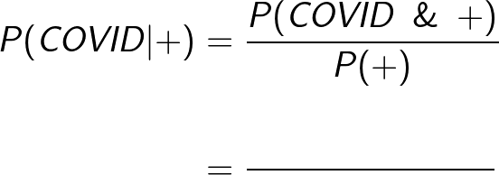
PS1, Q2
TRUE positives
ALL positives
 | test result | – test result | Totals
Covid | 85 | 15 | 100
No Covid | 148 | 9,752 | 9,900
Totals | 233 | 9,767 | 10,000

Slide 63
PS1, Q2
So P(COVID | +)
= (85 / 10,000) / (233 / 10,000)
= 85 / 233
= 0.36
 | test result | – test result | Totals
Covid | 85 | 15 | 100
No Covid | 148 | 9,752 | 9,900
Totals | 233 | 9,767 | 10,000

Slide 64
PS1, Q2(c)
Part (b) was about comparing this scenario to the mammograms example - see solutions.
Let’s do part (c) together…
(c) What is P(No Covid | –) ?

Slide 65
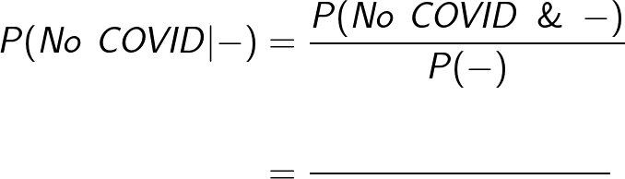
PS1, Q2(c)
Part (b) was about comparing this scenario to the mammograms example - see solutions.
Let’s do part (c) together…
(c) What is P(No Covid | –) ?
TRUE negatives
ALL negatives

Slide 66
PS1, Q2(c)
Part (b) was about comparing this scenario to the mammograms example - see solutions.
Let’s do part (c) together…
(c) What is P(No Covid | –) ?
TRUE negatives
 | + | – | Totals
Covid | 85 | 15 | 100
No Covid | 148 | 9,752 | 9,900
Totals | 233 | 9,767 | 10,000
ALL negatives

Slide 67
PS1, Q2(c)
Part (b) was about comparing this scenario to the mammograms example - see solutions.
Let’s do part (c) together…
(c) What is P(No Covid | –) ?
TRUE negatives
 | + | – | Totals
Covid | 85 | 15 | 100
No Covid | 148 | 9,752 | 9,900
Totals | 233 | 9,767 | 10,000
ALL negatives
= 9752 / 9767
= 0.998 (to 3dp)

Slide 68
PS1, Q2(c)
But Sophie, I thought this question was about Bayes rule!
We haven’t used it...have we??

Slide 69
PS1, Q2(c)
(c) What is P(No Covid | –) ?
How did we get these numbers in the table?
 | + | – | Totals
Covid | 85 | 15 | 100
No Covid | 148 | 9,752 | 9,900
Totals | 233 | 9,767 | 10,000

Slide 70
PS1, Q2(c)
(c) What is P(No Covid | –) ?
How did we get these numbers in the table?
 | test result | – test result
Covid | P(+ | Covid) * P(Covid) | P(– | Covid) * P(Covid)
No Covid | P(+ | No Covid) * P(No Covid) | P(– | No Covid) * P(No Covid)

Slide 71
PS1, Q2(c)
(c) What is P(No Covid | –) ?
Let’s add the column totals as well...
 | test result | – test result
Covid | P(+ | Covid) * P(Covid) | P(– | Covid) * P(Covid)
No Covid | P(+ | No Covid) * P(No Covid) | P(– | No Covid) * P(No Covid)
Totals | P(+ | No Covid) * P(No Covid) + P(+ | Covid) * P(Covid) | P(– | No Covid) * P(No Covid) + P(– | Covid) * P(Covid)

Slide 72
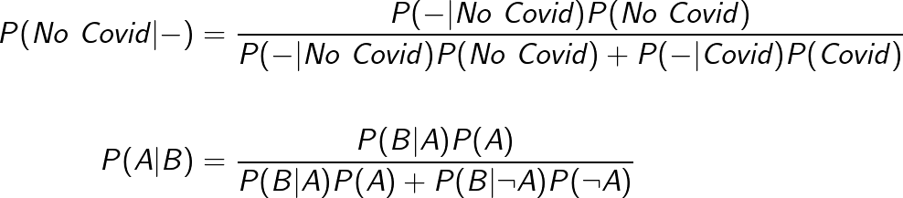
 | test result | – test result
Covid | P(+ | Covid) * P(Covid) | P(– | Covid) * P(Covid)
No Covid | P(+ | No Covid) * P(No Covid) | P(– | No Covid) * P(No Covid)
Totals | P(+ | No Covid) * P(No Covid) + P(+ | Covid) * P(Covid) | P(– | No Covid) * P(No Covid) + P(– | Covid) * P(Covid)

Slide 73
It’s Bayes rule!!!
 | test result | – test result
Covid | P(+ | Covid) * P(Covid) | P(– | Covid) * P(Covid)
No Covid | P(+ | No Covid) * P(No Covid) | P(– | No Covid) * P(No Covid)
Totals | P(+ | No Covid) * P(No Covid) + P(+ | Covid) * P(Covid) | P(– | No Covid) * P(No Covid) + P(– | Covid) * P(Covid)

Slide 74
PS1, Q2
See the solutions for the rest of Q2
Right now, let’s move on to a practice problem that is designed to help you with the concept of “updating your priors” as in Q1 on PS2...

Slide 75
Updating your priors

Slide 76
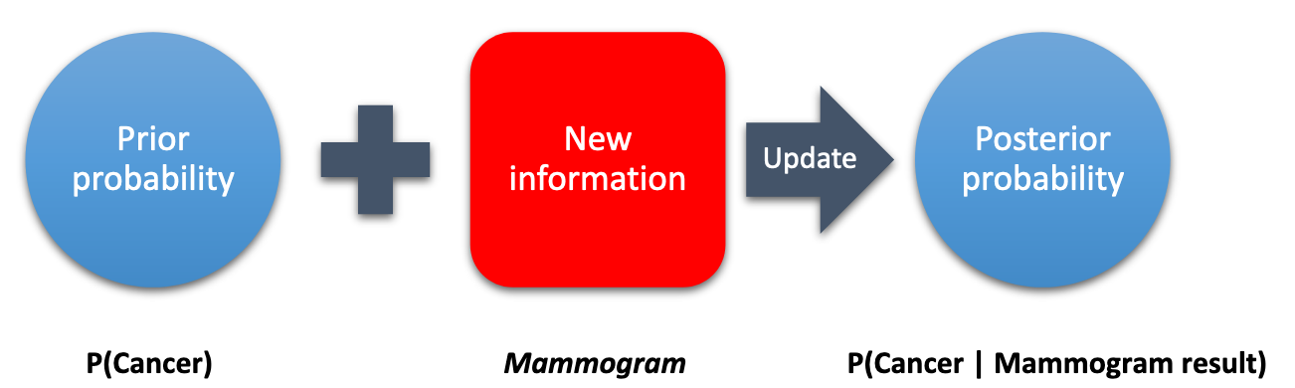
Bayesian updating
From Handout 3, Section 4

Slide 77
Bayesian updating
In reality, we don’t just do this once.
Bayesian updating is an iterative process!
From Handout 3, Section 4

Slide 78
Bayesian updating
When we incorporate new information using Bayes’ rule, we get a “posterior probability”...
...this then becomes our new prior when we want to include another piece of information!

Slide 79
Practice problem

Slide 80

Harvard psychologist Amy Cuddy features in one of the most-viewed TED talks of all time, with over 60 million views.
She describes her research on “power posing” – the idea that adopting a confident posture for 2 minutes can have significant effects on self-confidence and hormone levels.

Slide 81
In recent years, there has been a lively scholarly debate about whether power posing is real - does it actually have these effects, or was the initial study a fluke?
Let’s explore this from a Bayesian perspective!

Slide 82
Practice problem: Replication, Replication, Replication
How does this scenario relate to the more familiar case of medical testing?
Let’s write:
power pose to represent the case where power posing is real
¬power pose for the case where power posing is not real
+ for a study on power posing that finds a significant effect
– for a study that finds no significant effect

Slide 83
Practice problem: Replication, Replication, Replication
Before seeing any studies, my prior that power posing is real, P(power pose), is pretty low. (It’s weird, right?)
I’m going to say P(power pose) = 0.1
The probability that a study finds a significant effect given that power posing is real, P(+ | power pose) = 0.8
The probability that a study finds no significant effect given that power posing isn’t real, P(– | ¬power pose) = 0.4

Slide 84
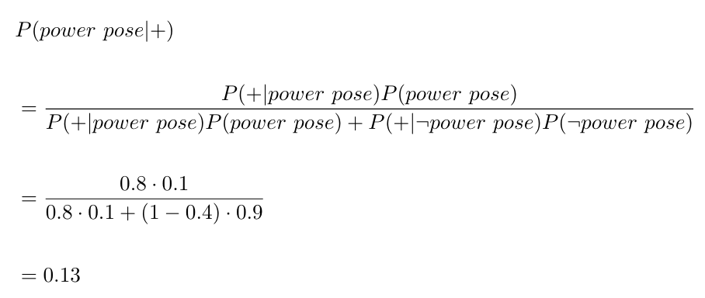
Practice problem: Replication, Replication, Replication
What happens to my prior, P(power pose), after Cuddy et al.’s first study comes out?

Slide 85
Practice problem: Replication, Replication, Replication
Before I read Cuddy et al.’s first study, I guess there was about a 10% chance that power posing is real.
After I read Cuddy et al.’s first study, I have updated my prior a little: I now think there’s a 13% chance that power posing is real.
What happens if another study on power posing is published?

Slide 86
Practice problem: Replication, Replication, Replication
Suppose the 2nd study also finds a significant effect of power posing.
Now we want to find P(power pose | +₂), the probability that power posing is real given that the 1st study was successfully replicated.
To do this, we can use Bayes rule in exactly the same way as before, except our prior P(power pose) is updated to reflect the result of the 1st study...

Slide 87
Practice problem: Replication, Replication, Replication
0.1
1st study, +₁
0.13
0.13
2nd study, +₂
?

Slide 88
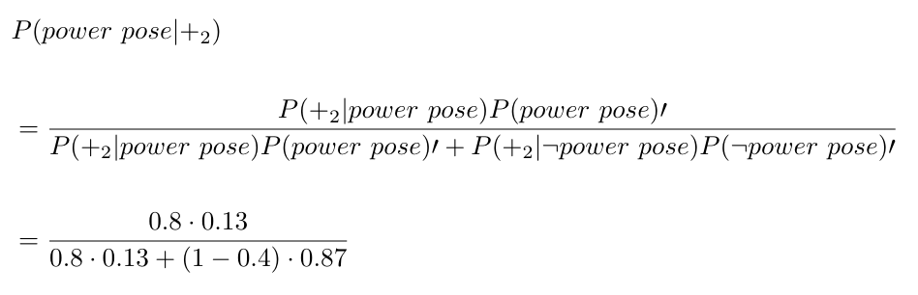
Practice problem: Replication, Replication, Replication
Note: I have written P(power pose)’ to denote our updated prior, which is P(power pose | +₁).
Everything else in the formula is the same.

Slide 89
Practice problem: Replication, Replication, Replication
What if the 2nd study found no effect of power posing?

Slide 90
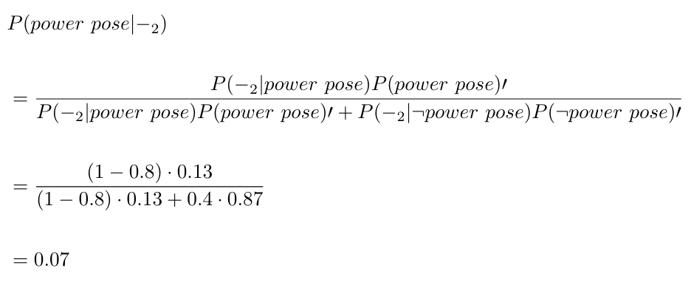
Practice problem: Replication, Replication, Replication
What if the 2nd study found no effect of power posing?

Slide 91
Practice problem: Replication, Replication, Replication
Before any studies, I thought that P(power pose) = 0.1
After one study that found an effect, and one that didn’t, I have actually downgraded the probability to just 0.07 = 7% !
Why?

Slide 92
Practice problem: Replication, Replication, Replication
Before any studies, I thought that P(power pose) = 0.1
After one study that found an effect, and one that didn’t, I have actually downgraded the probability to just 0.07 = 7% !
Why?
It comes back to my assumptions:
P(+ | power pose) = 0.8
P(– | ¬power pose) = 0.4

Slide 93
Practice problem: Replication, Replication, Replication
Before any studies, I thought that P(power pose) = 0.1
After one study that found an effect, and one that didn’t, I have actually downgraded the probability to just 0.07 = 7% !
Why?
It comes back to my assumptions:
P(+ | power pose) = 0.8
P(– | ¬power pose) = 0.4
Why did I make this probability so low?

Slide 94
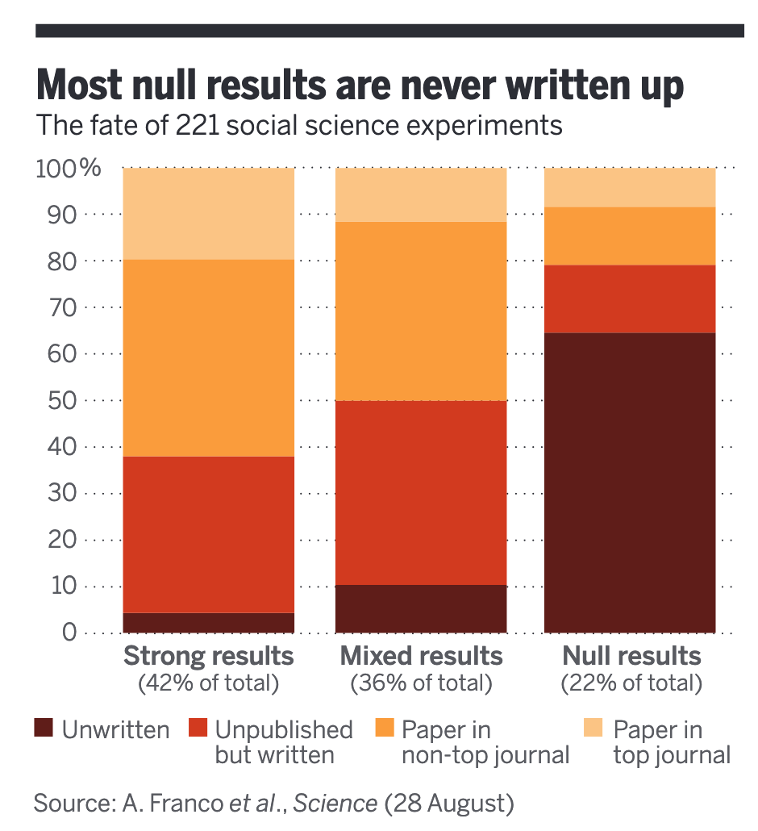
The File Drawer Problem
Null results - i.e. studies that fail to find a predicted effect - are much harder to publish in academic journals.
This is a BIG problem and it affects the way we interpret the studies that do get published.

Slide 95
Power posing might have some temporary effects on self-confidence… but the idea that it changes your hormone levels has failed to replicate.
Conclusion: Bayes rule can even help us to understand the scientific replication crisis! Cool!!

Slide 96

Great job everyone!!

